Slide 1

Minimizing DFA’s
By Partitioning

Slide 2
Why do we want to minimize a DFA?
Efficiency
Better understanding on the language recognized by the DFA
Computing the similarity between two Fas
Determining if two DFAs recognize the same language

Slide 3
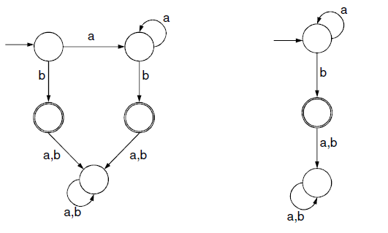
Two DFAs
Do these two DFAs accept the same language?

Slide 4
Minimization Process
Get rid of inaccessible states
Group equivalent states
  Two states are equivalent if all subsequent behavior from these states is the same.

Slide 5
DFA Minimization
Place the states of the DFA into two equivalence classes: final states and nonfinal states.
Repeat this step until there is no more change i.e., no new equivalence classes:
  Determine the transitions with respect to equivalence classes.
  For each state in the same equivalence class, if the transition is different than those in its group, partition it to a new equivalence class.

Slide 6
Minimizing DFA’s
Lots of methods
All involve finding equivalent states:
  States that go to equivalent states under all inputs (sounds recursive)
We will use the Partitioning Method

Slide 7
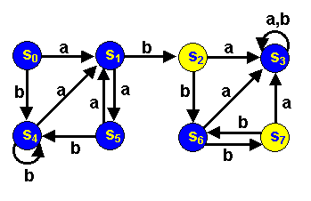
Minimizing DFA’s by Partitioning
Consider the following dfa (from Forbes Louis at U of KY):
Accepting states are yellow
Non-accepting states are blue
Are any states really the same?

Slide 8
S₂ and S₇ are really the same:
Both Final states
Both go to S6 under input b
Both go to S3 under an a
S0 and S5 really the same. Why?
We say each pair is equivalent
Are there any other equivalent states?
We can merge equivalent states into 1 state

Slide 9
Partitioning Algorithm
First
  Divide the set of states into
  Final and
  Non-final states
  Partition I
  Partition II
 | a | b
S₀ | S₁ | S₄
S₁ | S₅ | S₂
S₃ | S₃ | S₃
S₄ | S₁ | S₄
S₅ | S₁ | S₄
S₆ | S₃ | S₇
*S₂ | S₃ | S₆
*S₇ | S₃ | S₆

Slide 10
Partitioning Algorithm
Now
  See if states in each partition each go to the
  same partition
S₁ & S₆ are different from the rest of the states in Partition I
(but like each other)
We will move them to their own partition
 | a | b
S₀ | S₁ I | S₄ I
S₁ | S₅ I | S₂ II
S₃ | S₃ I | S₃ I
S₄ | S₁ I | S₄ I
S₅ | S₁ I | S₄ I
S₆ | S₃ I | S₇ II
*S₂ | S₃ I | S₆ I
*S₇ | S₃ I | S₆ I

Slide 11
Partitioning Algorithm
 | a | b
S₀ | S₁ | S₄
S₅ | S₁ | S₄
S₃ | S₃ | S₃
S₄ | S₁ | S₄
S₁ | S₅ | S₂
S₆ | S₃ | S₇
*S₂ | S₃ | S₆
*S₇ | S₃ | S₆

Slide 12
Partitioning Algorithm
Now again
  See if states in each partition each go to the same partition
  In Partition I, S₃ goes
  to a different partition
  from S_{0,} S₅ and S₄
  We’ll move S3 to its own partition
 | a | b
S₀ | S₁ III | S₄ I
S₅ | S₁ III | S₄ I
S₃ | S₃ I | S₃ I
S₄ | S₁ III | S₄ I
S₁ | S₅ I | S₂ II
S₆ | S₃ I | S₇ II
*S₂ | S₃ I | S₆ III
*S₇ | S₃ I | S₆ III

Slide 13
Partitioning Algorithm
Note changes in S_{6,} S₂ and S₇
 | a | b
S₀ | S₁ III | S₄ I
S₅ | S₁ III | S₄ I
S₄ | S₁ III | S₄ I
S₃ | S₃ IV | S₃ IV
S₁ | S₅ I | S₂ II
S₆ | S₃ IV | S₇ II
*S₂ | S₃ IV | S₆ III
*S₇ | S₃ IV | S₆ III

Slide 14
Partitioning Algorithm
Now S₆ goes to a different partition on an a from S₁
S₆ gets its own partition.
We now have 5 partitions
Note changes in S₂ and S₇
 | a | b
S₀ | S₁ III | S₄ I
S₅ | S₁ III | S₄ I
S₄ | S₁ III | S₄ I
S₃ | S₃ IV | S₃ IV
S₁ | S₅ I | S₂ II
S₆ | S₃ IV | S₇ II
*S₂ | S₃ IV | S₆ V
*S₇ | S₃ IV | S₆ V

Slide 15
Partitioning Algorithm
All states within each of the 5 partitions are identical.
We might as well call the states I, II III, IV and V.
 | a | b
S₀ | S₁ III | S₄ I
S₅ | S₁ III | S₄ I
S₄ | S₁ III | S₄ I
S₃ | S₃ IV | S₃ IV
S₁ | S₅ I | S₂ II
S₆ | S₃ IV | S₇ II
*S₂ | S₃ IV | S₆ V
*S₇ | S₃ IV | S₆ V

Slide 16
Partitioning Algorithm
Here they are:
 | a | b
I | III | I
*II | IV | V
III | I | II
IV | IV | IV
V | IV | II

Slide 17
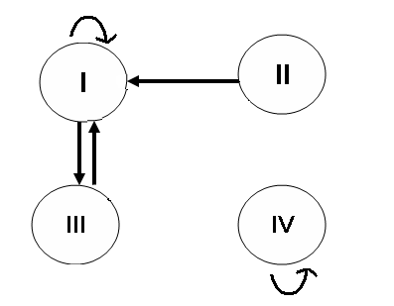
b
b
b
b
V
a
a
a
a
b
a
b

Slide 18
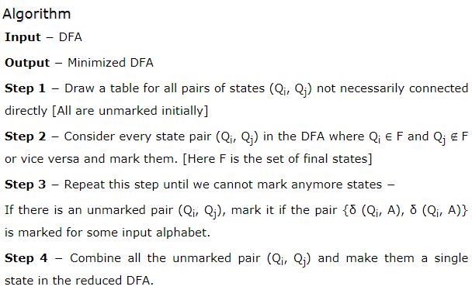
DFA Minimization using Myphill-Nerode Theorem (TF Algorithm)

Slide 19
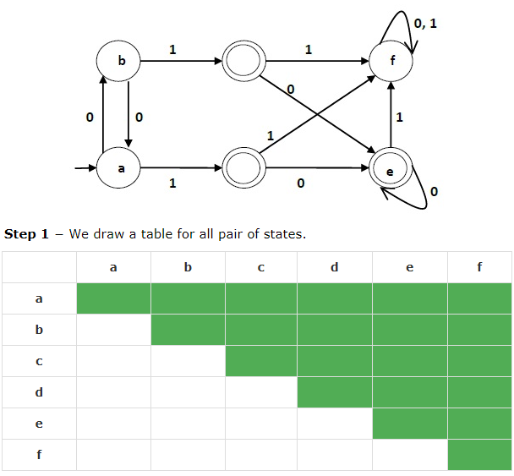
Example

Slide 20
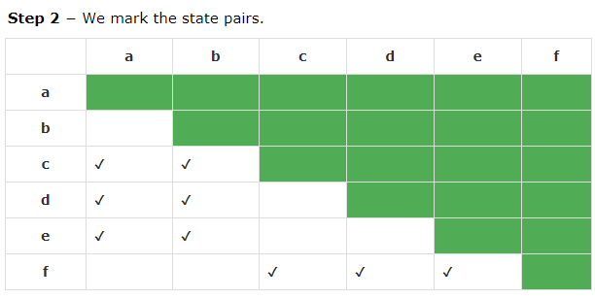

Slide 21
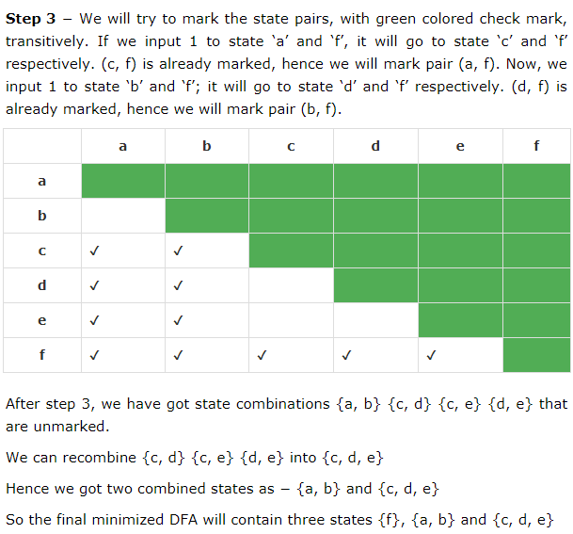

Slide 22
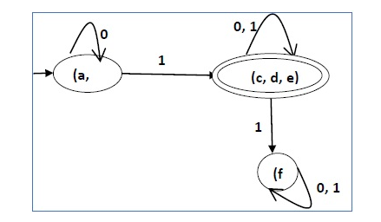
Minimized DFA

Slide 23
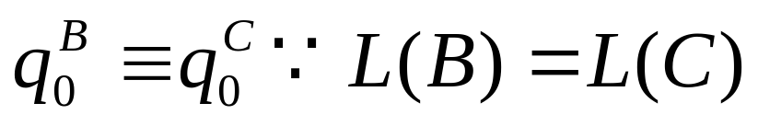
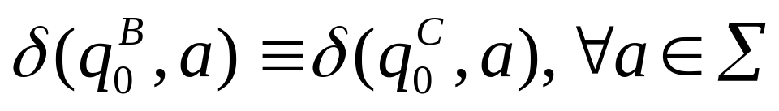
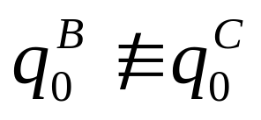
Minimized DFA Cannot be Beaten
Let B be the minimized DFA obtained by applying the TF-Algo to DFA A. We know that L(A) = L(B)
What if there existed a DFA C with L(C) = L(B) and fewer states than B?
If we run the TF-Algo on B “union” C
Also
If we could distinguish successors then

Slide 24

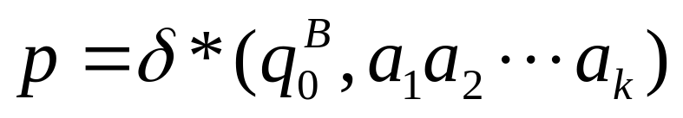
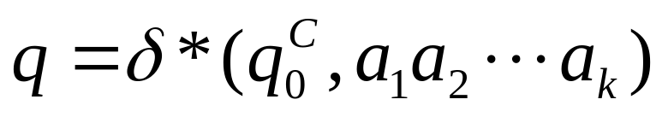
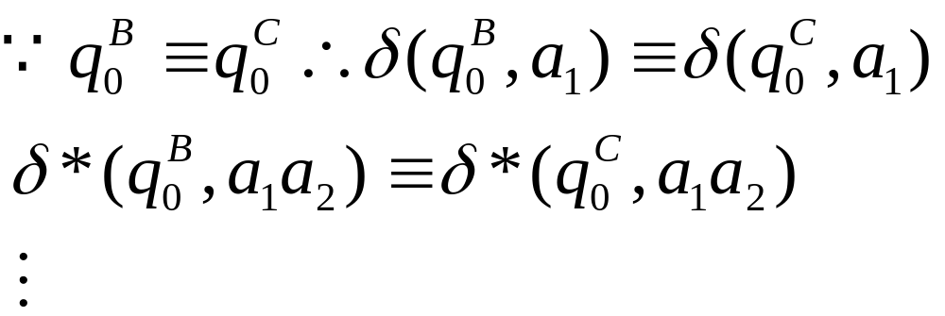


Minimized DFA Cannot be Beaten (cont)
Claim: For each state p in B there is at least one state q in C, s.t.
Proof: There are no inaccessible states, so
Now and
Since C has fewer states than B, there must be two states r & s of B s.t. For some state t of C. But CONTRADICTION!!

